Slide 1
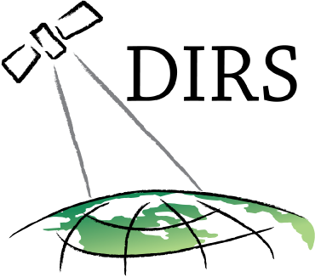
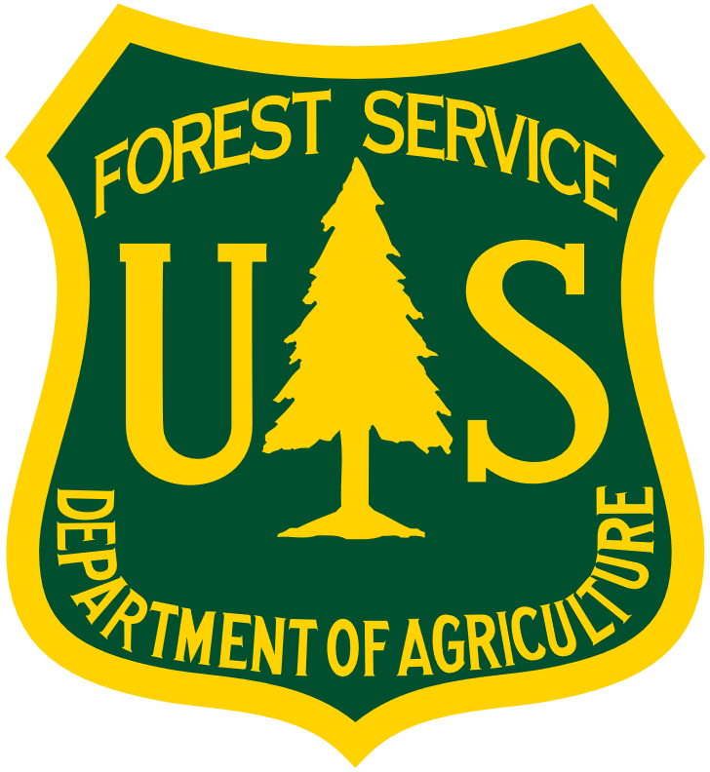

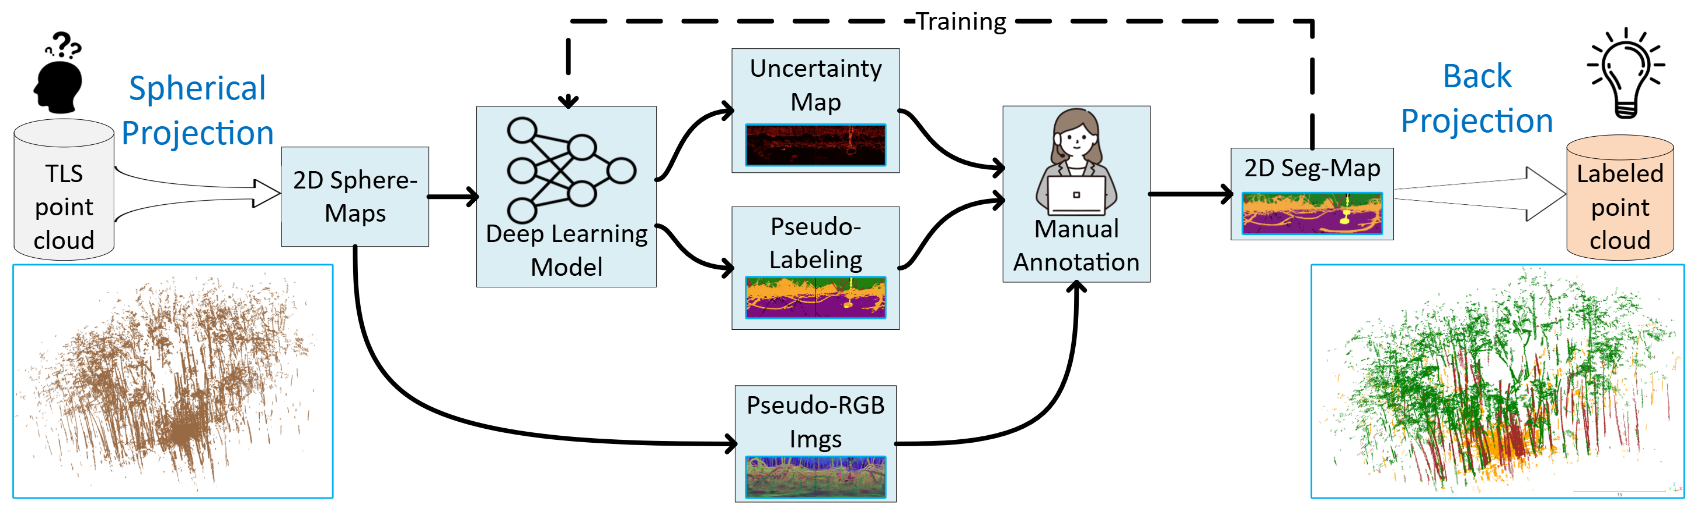
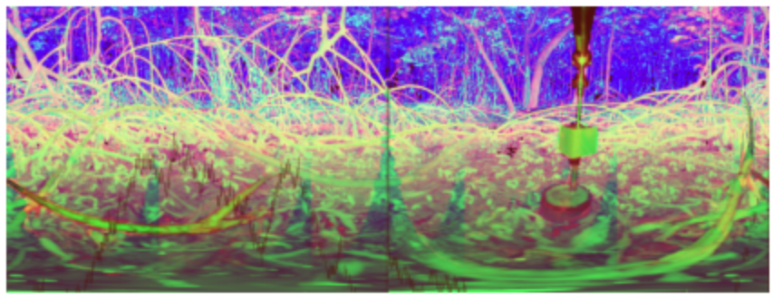
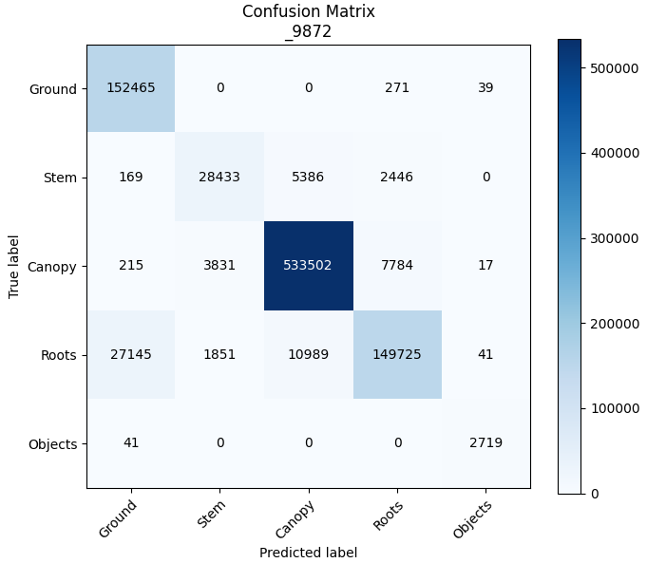
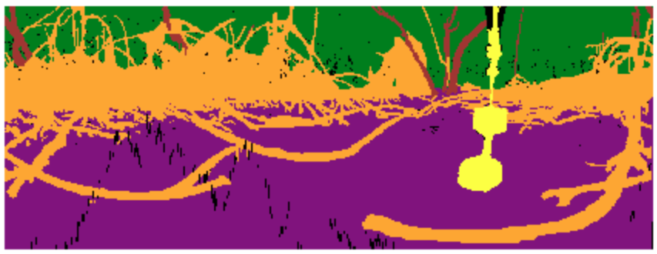
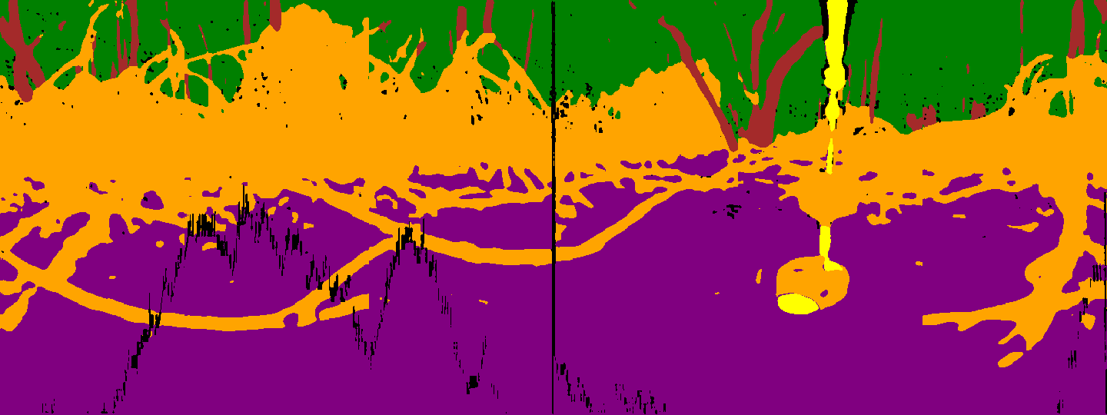
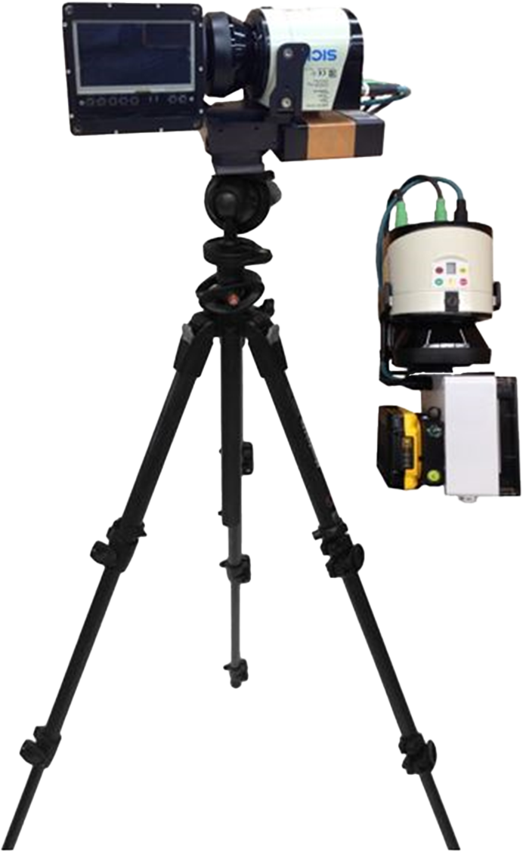
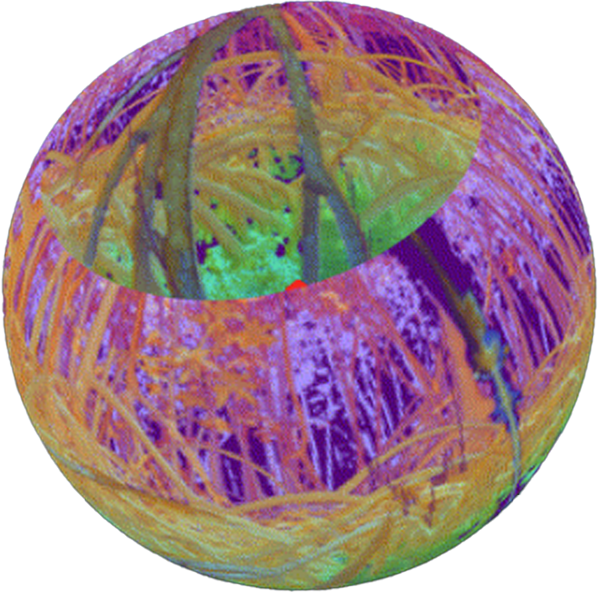
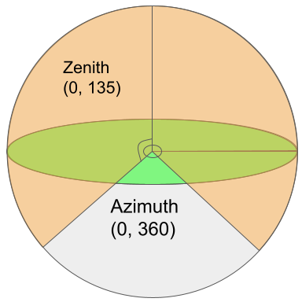
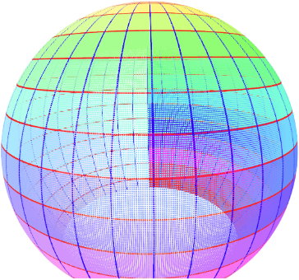
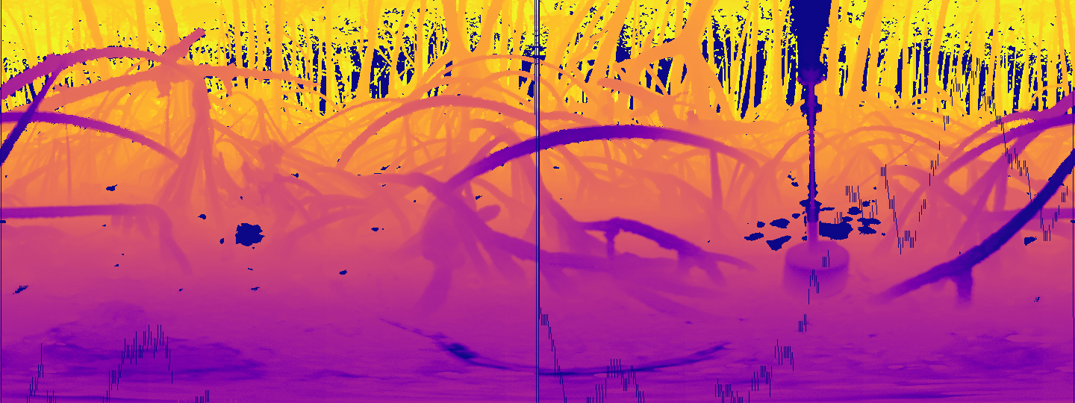
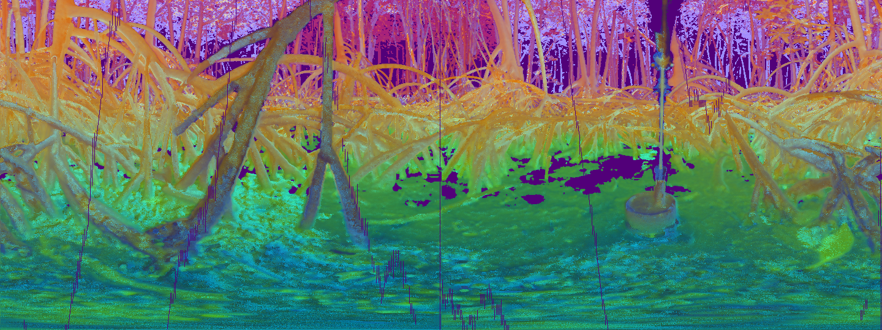
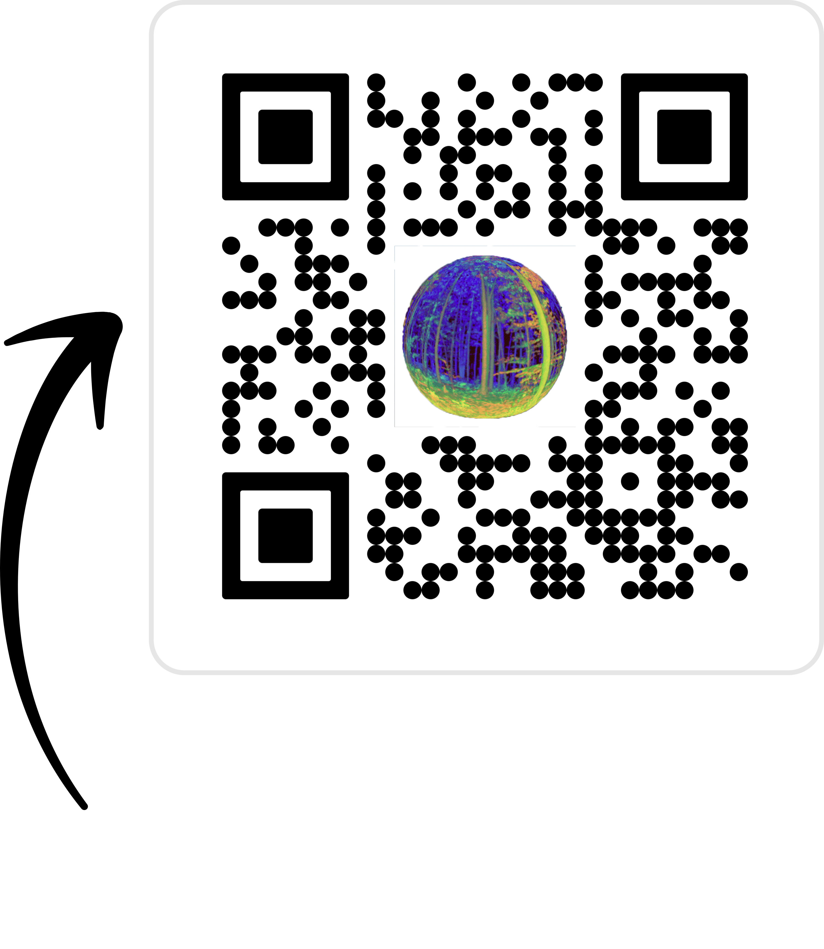
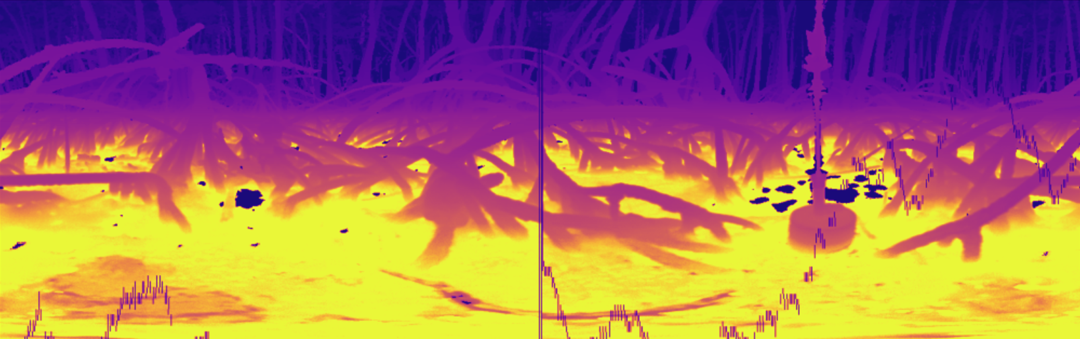
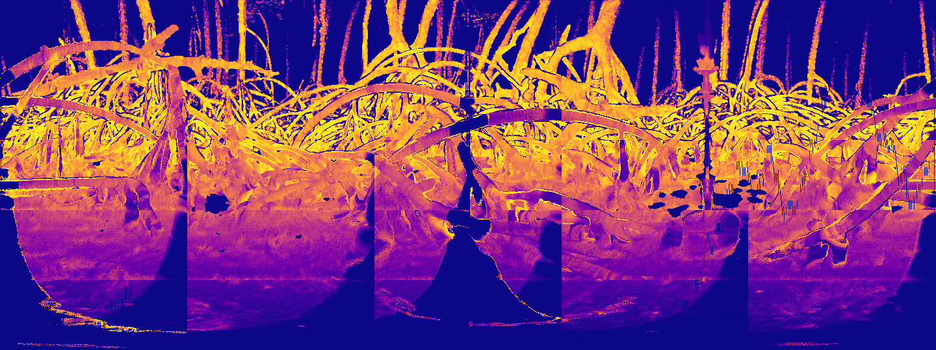
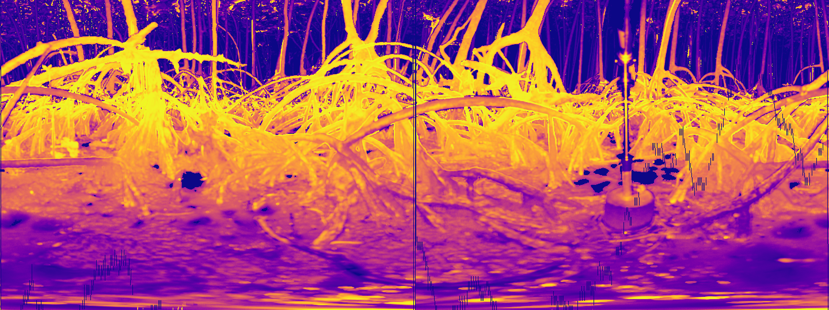
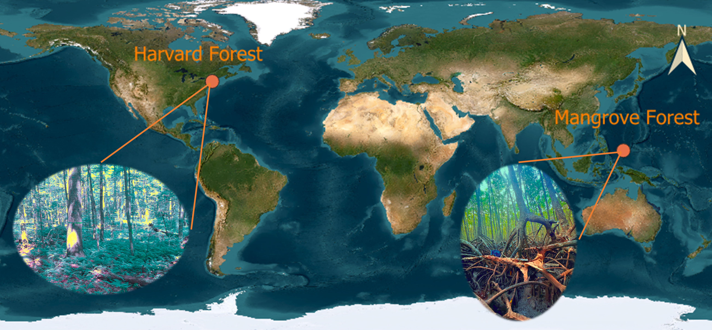
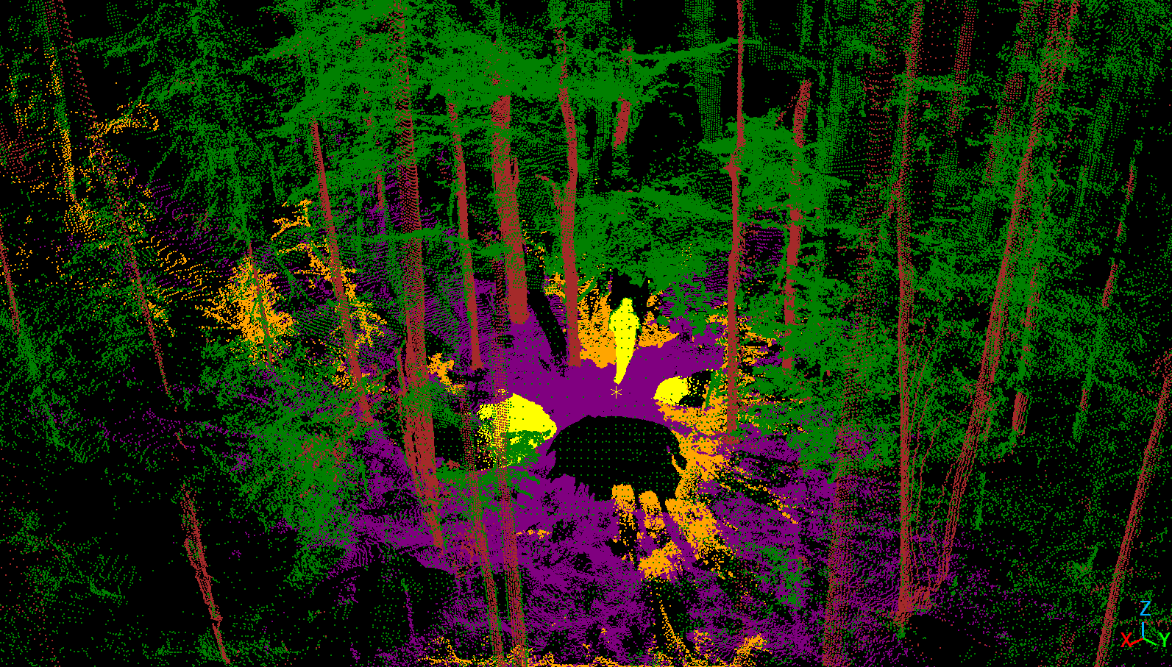
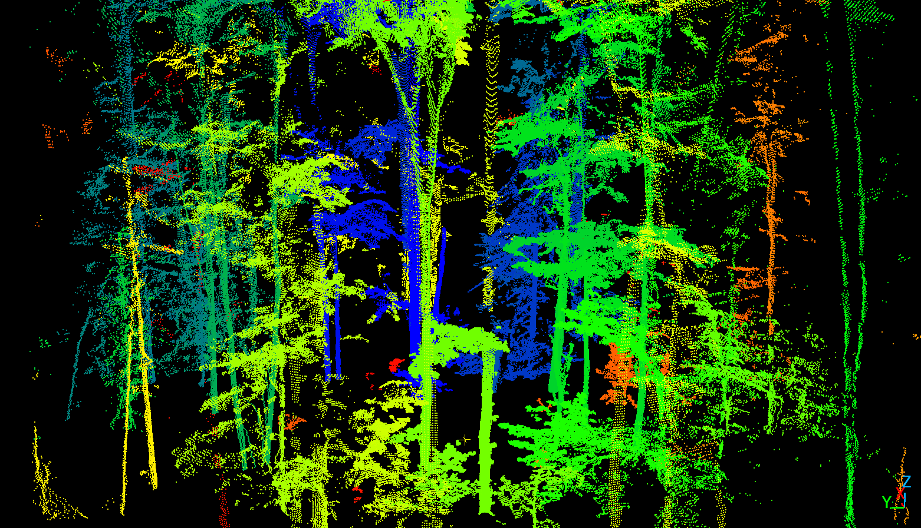

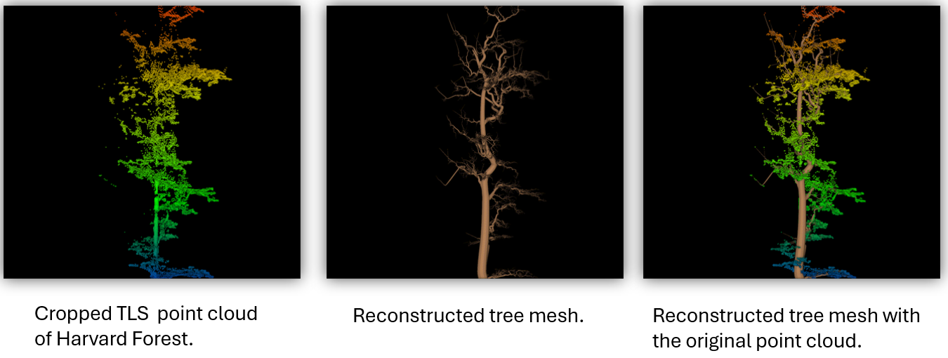
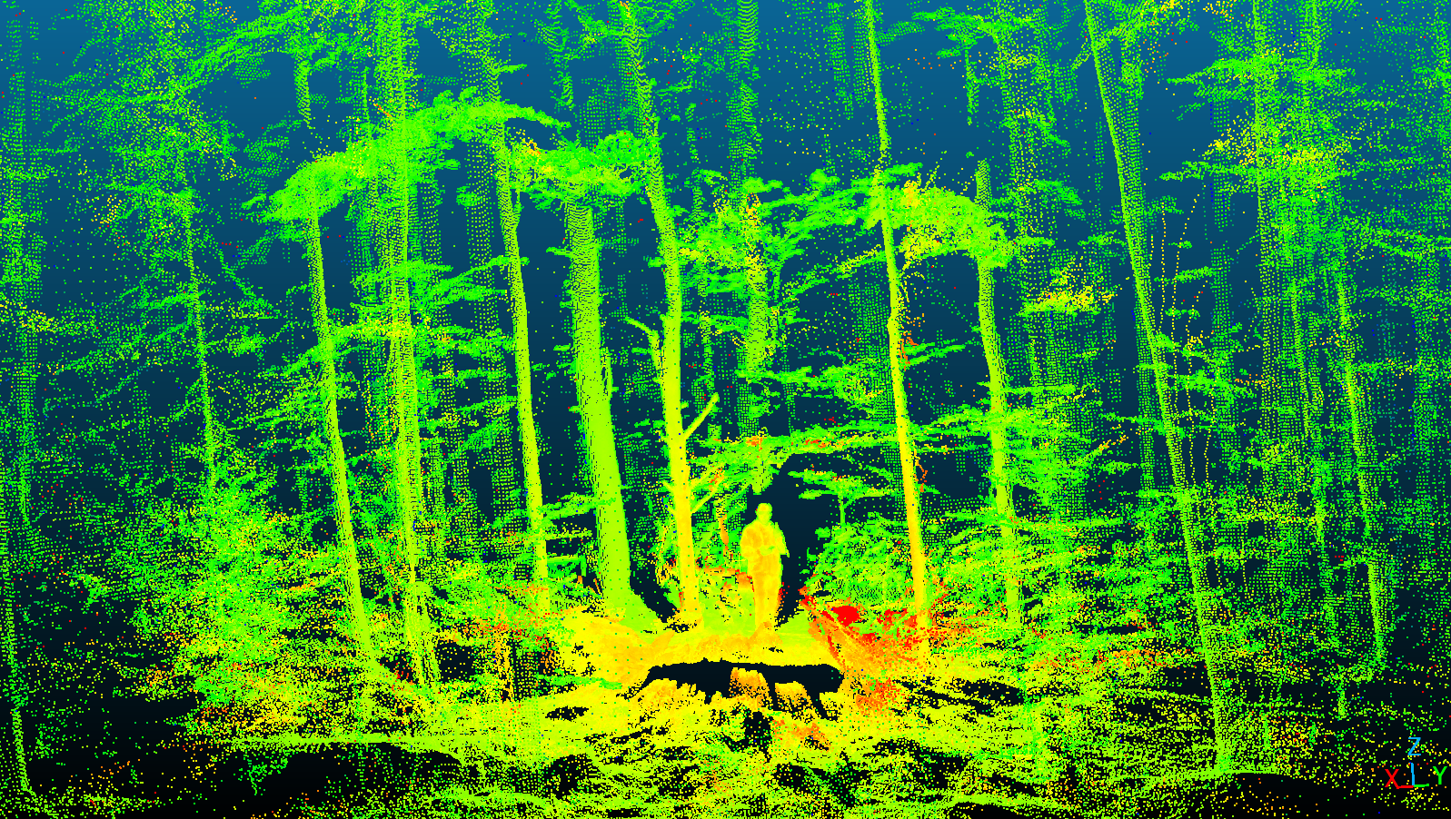
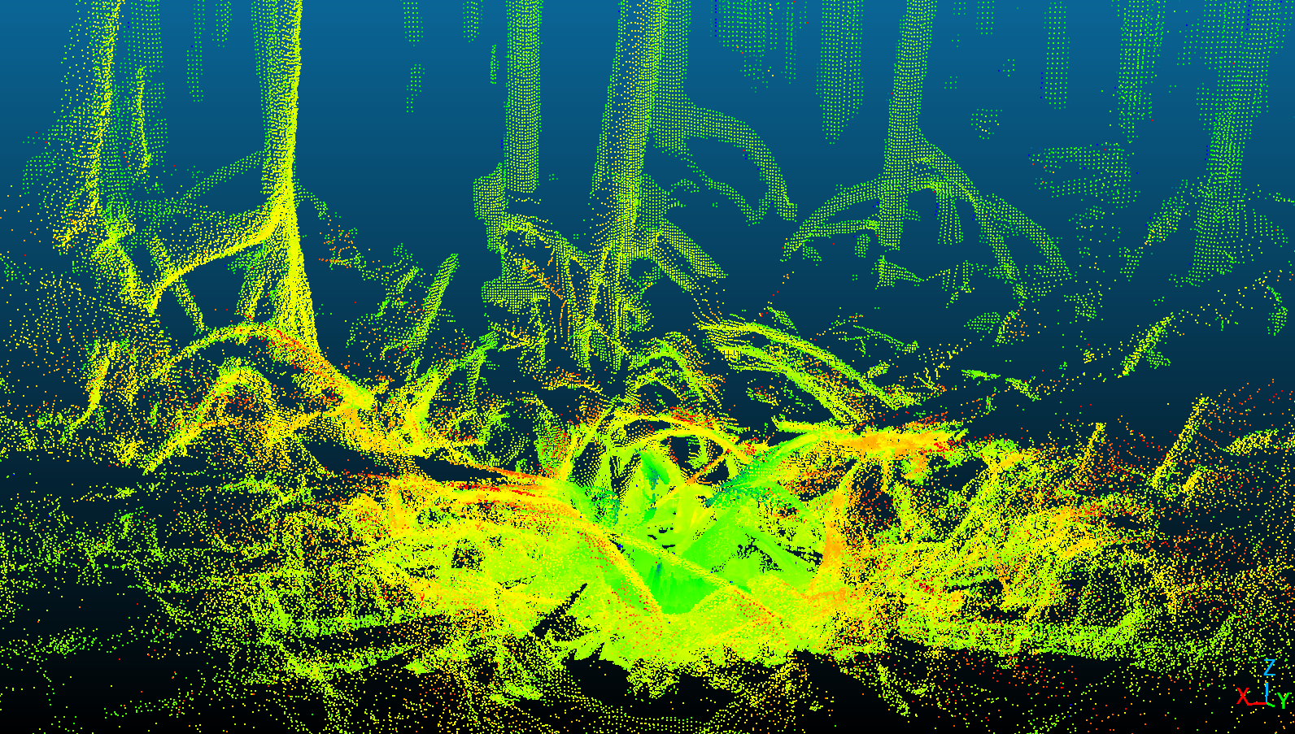
Mapping the Wild in 3D: LiDAR Insights into Forest Ecology
Fei Zhang¹, Rob Chancia¹, Josie Clapp¹, Richard MacKenzie², Jan van Aardt¹
1
2
Introduction
Semi-Automated LiDAR Annotation
Faster, smarter, accurate, and scalable
Results, Highlights & Future Work
Forests contain complex structures that shape biodiversity and ecosystem health. Using terrestrial LiDAR, we capture detailed 3D scans of two distinct environments: the temperate woodlands of Harvard Forest and the tangled mangrove forest of Palau. These 3D point clouds reveal patterns in vegetation that support research in ecology, conservation, and environmental monitoring.
2D Segmentation (Unet++) Metrics: oAcc = 0.874, mAcc = 0.749, mIoU = 0.610. | 3D Segmentation (PointNet++) Metrics: oAcc = 0.935, mAcc = 0.906, mIoU = 0.834.
Highlights Efficient Annotation Pipeline: Faster, high-quality 3D labeling using spherical projection + 2D deep learning models. Strong 2D Segmentation: ~90% accuracy, with good cross-scene generalization. Robust 3D Segmentation: PointNet++ reached 92–96% accuracy, though fine structures (e.g., roots, small objects) remain challenging. | Future work Add richer features (e.g., intensity, normals) for better 3D segmentation. Enhance tree isolation and tree reconstruction.
We introduce a three-stage pipeline for efficient 3D point cloud annotation: Spherical Projection TLS point clouds are unwrapped into 2D spherical maps based on azimuth and elevation, capturing features like intensity, range, and surface normals. Hybrid Annotation A segmentation model is trained on a small labeled set, then refined through active learning (manual correction of uncertain areas) and semi-supervised learning (confident pseudo-labels).
Back Projection Final 2D segmentation maps are projected back to 3D to generate labeled point clouds.
Single-Channel Spherical Feature Maps | Pseudo-RGB Spherical Map via Feature Stacking and PCA | Spherical Visualization of the 3D Scene
Pseudo-RGB map
Confusion matrix on sample dataset
Ground Truth
Scanning the Wild: LiDAR, Sites, and 3D Data
Pred
Mask
Wavelength | 905 nm
Max range | 50 m
Range error | 30 mm
Beam divergence | 0.86°
Angular resolution | 0.25°
Angular coverage | 360° × 270°
Scan duration | 33 s
Mass | 3.9 kg
Canopy Biomass LiDAR version 2.0 built by the UMass Boston, conceived by the KU Leuven, and prototyped by RIT.
Field of View of the CBL LiDAR. | Scan Pattern Projected onto a 3D Sphere. | Scan Pattern Projected onto a 3D Sphere.
Experimental Sites: Harvard Forest, USA (42°30′N, 72°12′W) and mangrove forests in Palau (7°31′49″N, 134°33′53″E), representing temperate and tropical ecosystems.
Raw terrestrial LiDAR point clouds from Harvard Forest (left) and the mangrove forest of Palau (right).
IV. Forest Scene Segmentation | V. Individual Tree Isolation
VI. Tree Reconstruction
Explore Our Projects
Scan & Connect!
A Glimpse Through the Laser’s Eye
Imagine walking through a forest deep, Where roots entwine and branches sweep. Not just a picture, not just a glance, But a world preserved in a digital dance.
With LiDAR’s gaze, the trees stand tall, Their forms captured, trunk and all. No rustling leaves, no shifting light, Yet their silent shapes still hold the sight.
Step in, reach out, and feel the space, Where science and nature meet face to face. A glimpse of forests, mapped and true— A story of the wild, revealed to you.
By ChatGPT

